Slide 1
Definition of business process
Process 1 – Administration of a blood transfusion
The process outlines the steps involved in analysing the patient’s blood group and crossmatch, followed by the administration of the blood transfusion.

Slide 2
Patient requiring a blood / blood products transfusion
ICCBBA*
GSRN
CPOE for blood/ blood products required for patient
ICCBBA: International Council for Commonality in Blood Banking Automation
CPOE: Computerized Provider Order Entry

Slide 3
Patient requiring a blood / blood products transfusion
ICCBBA*
GSRN
GLN/GSRN (+SRIN)
CPOE for blood/ blood products required for patient
Positive patient identity confirmed by HCP by scanning patient wristband and gaining verbal confirmation
ICCBBA: International Council for Commonality in Blood Banking Automation
CPOE: Computerized Provider Order Entry
HCP: Healthcare professionals

Slide 4
Patient requiring a blood / blood products transfusion
ICCBBA*
GSRN
GLN/GSRN (+SRIN)
GLN/GSRN (+SRIN)
CPOE for blood/ blood products required for patient
Positive patient identity confirmed by HCP by scanning patient wristband and gaining verbal confirmation
Blood sample x2 taken from patient and labelled at bedside
ICCBBA: International Council for Commonality in Blood Banking Automation
CPOE: Computerized Provider Order Entry
HCP: Healthcare professionals

Slide 5
Patient requiring a blood / blood products transfusion
ICCBBA*
GSRN
GLN/GSRN (+SRIN)
GLN/GSRN (+SRIN)
Blood sample taken to the laboratory for processing
CPOE for blood/ blood products required for patient
Positive patient identity confirmed by HCP by scanning patient wristband and gaining verbal confirmation
Blood sample x2 taken from patient and labelled at bedside
ICCBBA: International Council for Commonality in Blood Banking Automation
CPOE: Computerized Provider Order Entry
HCP: Healthcare professionals

Slide 6
Patient requiring a blood / blood products transfusion
ICCBBA*
GSRN
GLN/GSRN (+SRIN)
GLN/GSRN (+SRIN)
Blood sample taken to the laboratory for processing
GSRN (+SRIN)
CPOE for blood/ blood products required for patient
Positive patient identity confirmed by HCP by scanning patient wristband and gaining verbal confirmation
Blood sample x2 taken from patient and labelled at bedside
Two samples identified and checked that both are labelled identically
ICCBBA: International Council for Commonality in Blood Banking Automation
CPOE: Computerized Provider Order Entry
HCP: Healthcare professionals

Slide 7
Patient requiring a blood / blood products transfusion
ICCBBA*
GSRN
GLN/GSRN (+SRIN)
GLN/GSRN (+SRIN)
Blood sample taken to the laboratory for processing
GSRN (+SRIN)
Group and save takes place to match blood group/ antibodies and rhesus factor
CPOE for blood/ blood products required for patient
Positive patient identity confirmed by HCP by scanning patient wristband and gaining verbal confirmation
Blood sample x2 taken from patient and labelled at bedside
Two samples identified and checked that both are labelled identically
ICCBBA: International Council for Commonality in Blood Banking Automation
CPOE: Computerized Provider Order Entry
HCP: Healthcare professionals

Slide 8
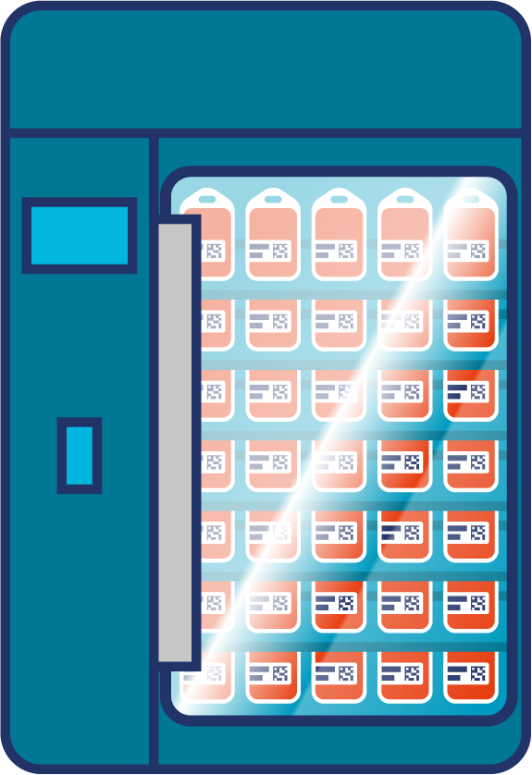
Patient requiring a blood / blood products transfusion
ICCBBA*
GSRN
GLN/GSRN (+SRIN)
GLN/GSRN (+SRIN)
Blood sample taken to the laboratory for processing
GSRN (+SRIN)
Group and save takes place to match blood group/ antibodies and rhesus factor
GLN/GSRN (+SRIN)
CPOE for blood/ blood products required for patient
Positive patient identity confirmed by HCP by scanning patient wristband and gaining verbal confirmation
Blood sample x2 taken from patient and labelled at bedside
Two samples identified and checked that both are labelled identically
Blood arrives from Blood Bank into hospital refrigeration
ICCBBA: International Council for Commonality in Blood Banking Automation
CPOE: Computerized Provider Order Entry
HCP: Healthcare professionals

Slide 9
Patient requiring a blood / blood products transfusion
ICCBBA*
GSRN
GLN/GSRN (+SRIN)
GLN/GSRN (+SRIN)
Blood sample taken to the laboratory for processing
GSRN (+SRIN)
Group and save takes place to match blood group/ antibodies and rhesus factor
GLN/GSRN (+SRIN)
CPOE for blood/ blood products required for patient
Positive patient identity confirmed by HCP by scanning patient wristband and gaining verbal confirmation
Blood sample x2 taken from patient and labelled at bedside
Two samples identified and checked that both are labelled identically
Blood arrives from Blood Bank into hospital refrigeration
2 clinical staff collect blood from Blood Bank and return to patient for administration
ICCBBA: International Council for Commonality in Blood Banking Automation
CPOE: Computerized Provider Order Entry
HCP: Healthcare professionals

Slide 10
Patient requiring a blood / blood products transfusion
ICCBBA*
GSRN
GLN/GSRN (+SRIN)
GLN/GSRN (+SRIN)
Blood sample taken to the laboratory for processing
GSRN (+SRIN)
Group and save takes place to match blood group/ antibodies and rhesus factor
GLN/GSRN (+SRIN)
CPOE for blood/ blood products required for patient
Positive patient identity confirmed by HCP by scanning patient wristband and gaining verbal confirmation
Blood sample x2 taken from patient and labelled at bedside
Two samples identified and checked that both are labelled identically
Blood arrives from Blood Bank into hospital refrigeration
GLN/GSRN (+SRIN)
2 clinical staff collect blood from Blood Bank and return to patient for administration
Positive patient identification by both HCP by scanning the wristband and gaining verbal confirmation
ICCBBA: International Council for Commonality in Blood Banking Automation
CPOE: Computerized Provider Order Entry
HCP: Healthcare professionals

Slide 11
Patient requiring a blood / blood products transfusion
ICCBBA*
GSRN
GLN/GSRN (+SRIN)
GLN/GSRN (+SRIN)
Blood sample taken to the laboratory for processing
GSRN (+SRIN)
Group and save takes place to match blood group/ antibodies and rhesus factor
GLN/GSRN (+SRIN)
CPOE for blood/ blood products required for patient
Positive patient identity confirmed by HCP by scanning patient wristband and gaining verbal confirmation
Blood sample x2 taken from patient and labelled at bedside
Two samples identified and checked that both are labelled identically
Blood arrives from Blood Bank into hospital refrigeration
GLN/GSRN (+SRIN)
GLN/GSRN (+SRIN)
2 clinical staff collect blood from Blood Bank and return to patient for administration
HCP double verify the details on the blood product and verify these are correct and completes vital observations as a baseline
Positive patient identification by both HCP by scanning the wristband and gaining verbal confirmation
ICCBBA: International Council for Commonality in Blood Banking Automation
CPOE: Computerized Provider Order Entry
HCP: Healthcare professionals

Slide 12
Patient requiring a blood / blood products transfusion
ICCBBA*
GSRN
GLN/GSRN (+SRIN)
GLN/GSRN (+SRIN)
Blood sample taken to the laboratory for processing
GSRN (+SRIN)
Group and save takes place to match blood group/ antibodies and rhesus factor
GLN/GSRN (+SRIN)
CPOE for blood/ blood products required for patient
Positive patient identity confirmed by HCP by scanning patient wristband and gaining verbal confirmation
Blood sample x2 taken from patient and labelled at bedside
Two samples identified and checked that both are labelled identically
Blood arrives from Blood Bank into hospital refrigeration
GLN/GSRN (+SRIN)
GLN/GSRN (+SRIN)
GLN/GSRN (+SRIN)
2 clinical staff collect blood from Blood Bank and return to patient for administration
HCP connects Intravenous infusion and stays with the patient
HCP double verify the details on the blood product and verify these are correct and completes vital observations as a baseline
Positive patient identification by both HCP by scanning the wristband and gaining verbal confirmation
ICCBBA: International Council for Commonality in Blood Banking Automation
CPOE: Computerized Provider Order Entry
HCP: Healthcare professionals

Slide 13
Patient requiring a blood / blood products transfusion
ICCBBA*
GSRN
GLN/GSRN (+SRIN)
GLN/GSRN (+SRIN)
Blood sample taken to the laboratory for processing
GSRN (+SRIN)
Group and save takes place to match blood group/ antibodies and rhesus factor
GLN/GSRN (+SRIN)
CPOE for blood/ blood products required for patient
Positive patient identity confirmed by HCP by scanning patient wristband and gaining verbal confirmation
Blood sample x2 taken from patient and labelled at bedside
Two samples identified and checked that both are labelled identically
Blood arrives from Blood Bank into hospital refrigeration
GLN/GSRN (+SRIN)
GLN/GSRN (+SRIN)
GLN/GSRN (+SRIN)
GLN/GSRN (+SRIN)
2 clinical staff collect blood from Blood Bank and return to patient for administration
Vital observations are taken every 15 mins and patient observed for signs of a reaction
HCP connects Intravenous infusion and stays with the patient
HCP double verify the details on the blood product and verify these are correct and completes vital observations as a baseline
Positive patient identification by both HCP by scanning the wristband and gaining verbal confirmation
ICCBBA: International Council for Commonality in Blood Banking Automation
CPOE: Computerized Provider Order Entry
HCP: Healthcare professionals

Slide 14
Patient requiring a blood / blood products transfusion
ICCBBA*
GSRN
GLN/GSRN (+SRIN)
GLN/GSRN (+SRIN)
Blood sample taken to the laboratory for processing
GSRN (+SRIN)
Group and save takes place to match blood group/ antibodies and rhesus factor
GLN/GSRN (+SRIN)
CPOE for blood/ blood products required for patient
Positive patient identity confirmed by HCP by scanning patient wristband and gaining verbal confirmation
Blood sample x2 taken from patient and labelled at bedside
Two samples identified and checked that both are labelled identically
Blood arrives from Blood Bank into hospital refrigeration
Transfusion complete
GLN/GSRN (+SRIN)
GLN/GSRN (+SRIN)
GLN/GSRN (+SRIN)
GLN/GSRN (+SRIN)
2 clinical staff collect blood from Blood Bank and return to patient for administration
Vital observations are taken every 15 mins and patient observed for signs of a reaction
HCP connects Intravenous infusion and stays with the patient
HCP double verify the details on the blood product and verify these are correct and completes vital observations as a baseline
Positive patient identification by both HCP by scanning the wristband and gaining verbal confirmation
ICCBBA: International Council for Commonality in Blood Banking Automation
CPOE: Computerized Provider Order Entry
HCP: Healthcare professionals

Slide 15
Benefits
Clinical
Non clinical
Improved patient safety (serious untoward incidents) and outcomes by preventing errors
No delays in results and treatment due to error elimination
Electronic ordering and collection eliminate paper order readability and transcription incidents
Reduced errors related to pathology collections
Better care for patients through reduced repeated processes and costs
Reduction in blood product wastage
Automated process reduces lab data entry efforts
Unique patient identification reduces errors in labelling
Reduced amount of testing needed due to incorrect labelling, saving time and resources
Enhancing job satisfaction and efficiency

