Slide 1
Definition of business process
Process 2 – Patient access to discharged medication
This process describes the transition of care when a patient is discharged from hospital and obtains their prescribed medicines at a community pharmacy. By using GS1 standards and regulatory verification systems such as the European FMD and the US DSCSA, pharmacies can ensure the authenticity, traceability and correct dispensing of prescription medicines.

Slide 2
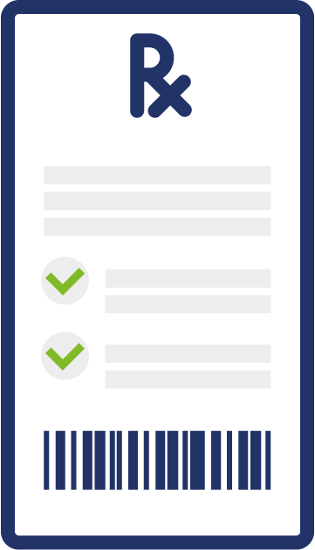

Where the standards fit in the process map
Patient is discharged from hospital and requieres discharged medication
linked to the unique patient identification.
GTIN / GSRN

Slide 3


Where the standards fit in the process map
Patient is discharged from hospital and requieres discharged medication
linked to the unique patient identification.
Pharmacy receives the prescription.
GTIN / GSRN
GTIN / GSRN / GLN

Slide 4


Where the standards fit in the process map
Patient is discharged from hospital and requieres discharged medication
linked to the unique patient identification.
Pharmacy receives the prescription.
The Pharmacist checks the treatment against discharge notes.
GTIN / GSRN
GTIN / GSRN / GLN
GTIN / GSRN

Slide 5
Where the standards fit in the process map
Patient is discharged from hospital and requieres discharged medication
linked to the unique patient identification.
Pharmacists locates the product, scans the GS1 DataMatrix on the product pack to retrieve product ID and production attributes.
Pharmacy receives the prescription.
The Pharmacist checks the treatment against discharge notes.
GTIN / GSRN
GTIN / GSRN / GLN
GTIN / GSRN
GTIN

Slide 6
Where the standards fit in the process map
Patient is discharged from hospital and requieres discharged medication
linked to the unique patient identification.
Pharmacists locates the product, scans the GS1 DataMatrix on the product pack to retrieve product ID and production attributes.
Pharmacy receives the prescription.
The Pharmacist checks the treatment against discharge notes.
GTIN / GSRN
GTIN / GSRN / GLN
GTIN / GSRN
GTIN
Pharmacy staff confirm the product matches the prescribed treatment and, where applicable, link it to the patient for reimbursement in line with national requirements, while verifying expiry and recall status at the point of dispensing.
GTIN

Slide 7


Where the standards fit in the process map
Patient is discharged from hospital and requieres discharged medication
linked to the unique patient identification.
Pharmacists locates the product, scans the GS1 DataMatrix on the product pack to retrieve product ID and production attributes.
Pharmacy receives the prescription.
The Pharmacist checks the treatment against discharge notes.
GTIN / GSRN
GTIN / GSRN / GLN
GTIN / GSRN
GTIN
Once verification is complete, the pharmacist dispenses the medicine, and inventory is updated automatically.
Pharmacy staff confirm the product matches the prescribed treatment and, where applicable, link it to the patient for reimbursement in line with national requirements, while verifying expiry and recall status at the point of dispensing.
GTIN / GSRN / GLN
GTIN

Slide 8
Where the standards fit in the process map
Patient is discharged from hospital and requieres discharged medication
linked to the unique patient identification.
Pharmacists locates the product, scans the GS1 DataMatrix on the product pack to retrieve product ID and production attributes.
Pharmacy receives the prescription.
The Pharmacist checks the treatment against discharge notes.
GTIN / GSRN
GTIN / GSRN / GLN
GTIN / GSRN
GTIN
The pharmacist provides advice to support safe use at home, with optional access to digital instructions via 2D barcode scanning.
Once verification is complete, the pharmacist dispenses the medicine, and inventory is updated automatically.
Pharmacy staff confirm the product matches the prescribed treatment and, where applicable, link it to the patient for reimbursement in line with national requirements, while verifying expiry and recall status at the point of dispensing.
GTIN
GTIN / GSRN / GLN
GTIN

Slide 9
Benefits
Clinical
Non clinical
Ensures patients receive authentic, verified medicines at discharge
Reduces the risk of expired or recalled products reaching patients
Improves continuity of care between hospital and community pharmacy
Complies with major regulatory frameworks (EU FMD, US DSCSA)
Strengthens supply chain traceability from hospital to home
Supports standardised workflows across pharmacies and healthcare systems
Reduces manual checks and improves operational efficiency
Minimises administrative burden by automating verification and documentation

