Slide 1
Definition of business process
Process 1 – The process of a patient undergoing imaging
The imaging process enables healthcare professionals to have views of the patient to aid diagnosis and treatment.

Slide 2
Imaging (Xray/MRI/CT/US)
Elective access

Slide 3
Imaging (Xray/MRI/CT/US)
Elective access
Emergency access
Linked to Emergency Department

Slide 4
Imaging (Xray/MRI/CT/US)
Elective access
Patient referral
Emergency access
Linked to Emergency Department

Slide 5
Imaging (Xray/MRI/CT/US)
Elective access
Patient referral
GLN/GSRN (+SRIN)
Positive patient identification takes place when patient arrives in department
Emergency access
Linked to Emergency Department

Slide 6
Imaging (Xray/MRI/CT/US)
Elective access
Patient referral
GLN/GSRN (+SRIN)
Positive patient identification takes place when patient arrives in department
Emergency access
Linked to Emergency Department
Imaging

Slide 7
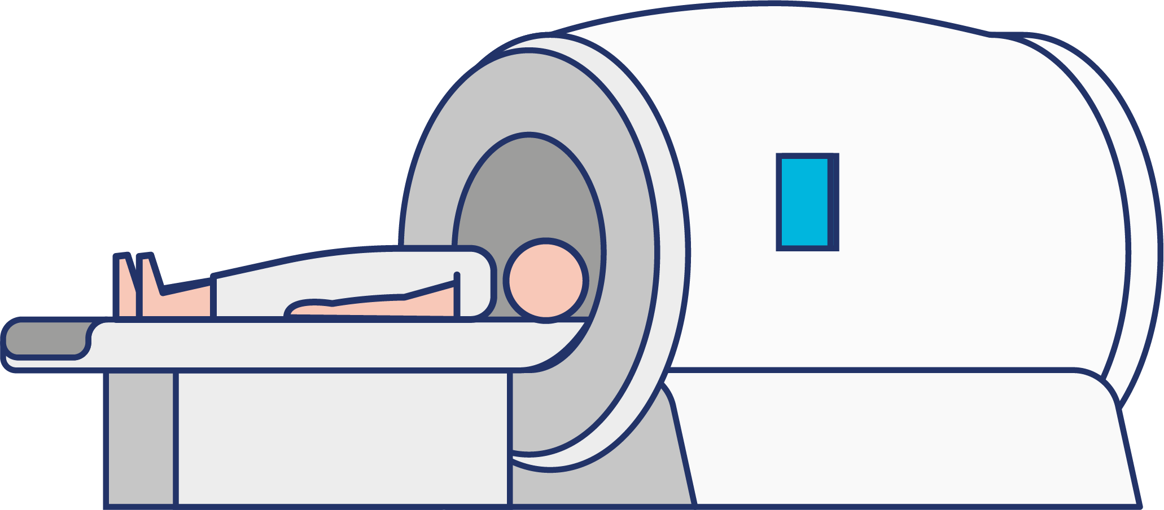
Imaging (Xray/MRI/CT/US)
MRI
GLN/GSRN (+SRIN)/ GIAI
Elective access
Patient referral
GLN/GSRN (+SRIN)
Positive patient identification takes place when patient arrives in department
Emergency access
Linked to Emergency Department
Imaging

Slide 8
Imaging (Xray/MRI/CT/US)
MRI checklist implantable (GTIN) MRI safe/not safe
MRI
GLN/GSRN (+SRIN)/ GIAI
Procurement
Elective access
Patient referral
GLN/GSRN (+SRIN)
Positive patient identification takes place when patient arrives in department
Emergency access
Linked to Emergency Department
Imaging

Slide 9
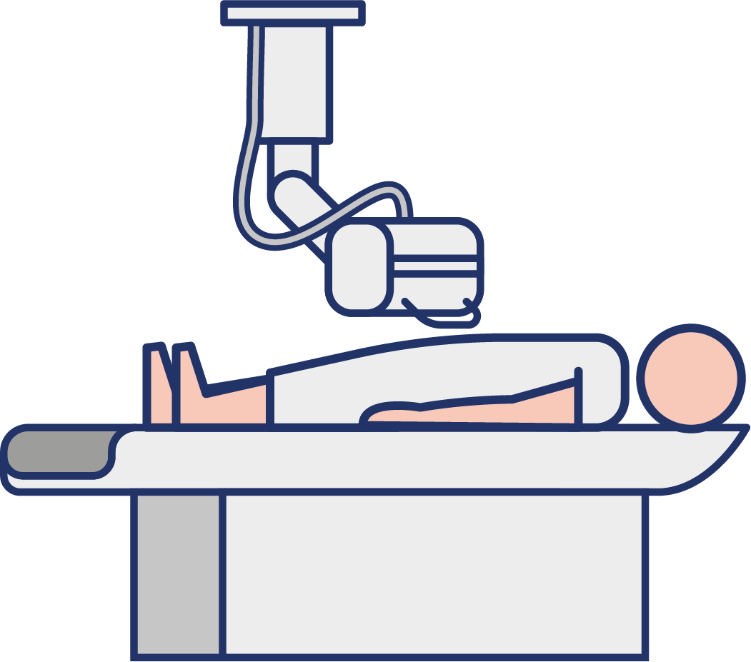
Imaging (Xray/MRI/CT/US)
MRI checklist implantable (GTIN) MRI safe/not safe
MRI
GLN/GSRN (+SRIN)/ GIAI
Procurement
Elective access
XRAY
GLN/GSRN (+SRIN)/ GIAI
Patient referral
GLN/GSRN (+SRIN)
Positive patient identification takes place when patient arrives in department
Emergency access
Linked to Emergency Department
Imaging

Slide 10
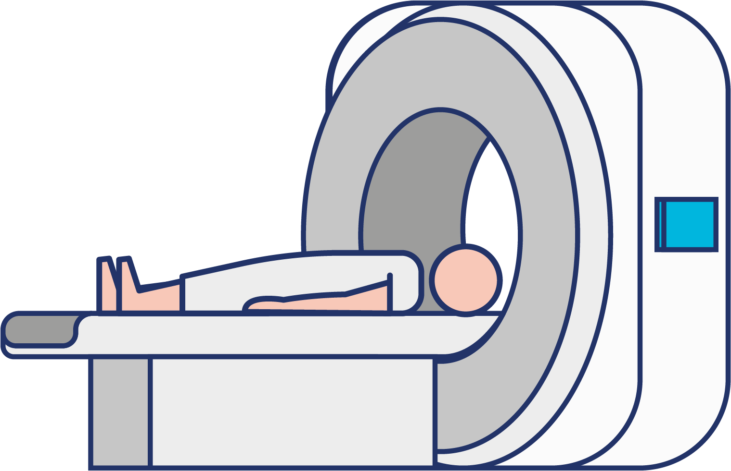
Imaging (Xray/MRI/CT/US)
MRI checklist implantable (GTIN) MRI safe/not safe
MRI
GLN/GSRN (+SRIN)/ GIAI
Procurement
Elective access
XRAY
GLN/GSRN (+SRIN)/ GIAI
Patient referral
GLN/GSRN (+SRIN)
CT
Positive patient identification takes place when patient arrives in department
GLN/GSRN (+SRIN)/ GIAI
Emergency access
Linked to Emergency Department
Imaging

Slide 11
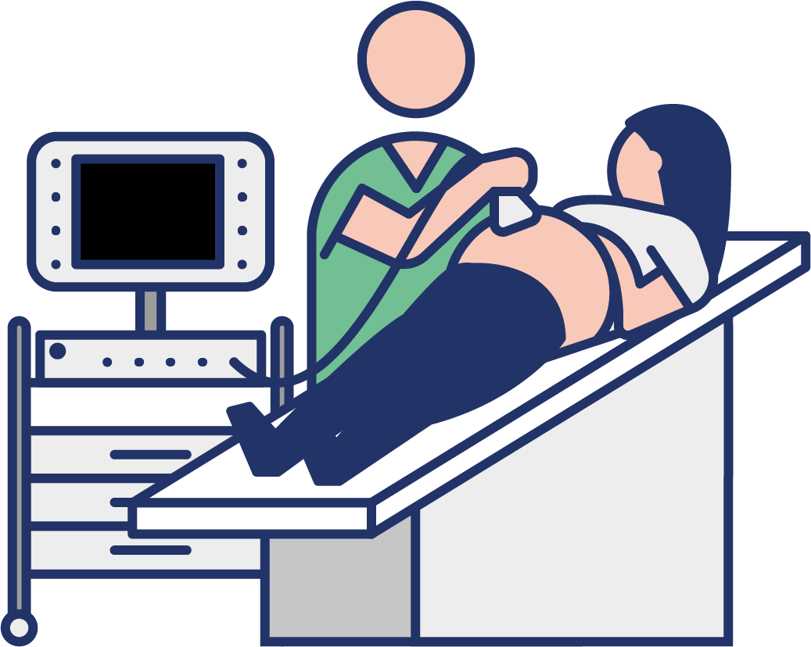
Imaging (Xray/MRI/CT/US)
MRI checklist implantable (GTIN) MRI safe/not safe
MRI
GLN/GSRN (+SRIN)/ GIAI
Procurement
Elective access
XRAY
GLN/GSRN (+SRIN)/ GIAI
Patient referral
GLN/GSRN (+SRIN)
CT
Positive patient identification takes place when patient arrives in department
GLN/GSRN (+SRIN)/ GIAI
Emergency access
Linked to Emergency Department
ULTRASOUND
GLN/GSRN (+SRIN)/ GIAI
Imaging

Slide 12
Imaging (Xray/MRI/CT/US)
MRI checklist implantable (GTIN) MRI safe/not safe
MRI
GLN/GSRN (+SRIN)/ GIAI
Procurement
Elective access
XRAY
GLN/GSRN (+SRIN)/ GIAI
Patient referral
GLN/GSRN (+SRIN)
CT
GSRN/GDTI
Positive patient identification takes place when patient arrives in department
GLN/GSRN (+SRIN)/ GIAI
All imaging reported by radiologists and a report generated to aid diagnosis by doctor
Emergency access
Linked to Emergency Department
ULTRASOUND
GLN/GSRN (+SRIN)/ GIAI
Imaging

Slide 13
Benefits
Clinical
Enhanced patient safety:
Reduces the risk of administering incorrect treatments or procedures
Ensures that the correct patient receives the appropriate imaging minimising potential radiation exposure
Prevents inaccurate data / images in medical records, which can result in misdiagnoses or inappropriate treatments
Minimises the occurrence of repeat imaging due to identification errors, saving time and resources
Time savings for radiology department staff for MRI

