Slide 1
Definition of business process
Process 1 – Traceability of laundry
The process in hospitals refers to a comprehensive system designed to track and manage the lifecycle of all textiles used within the healthcare facility.

Slide 2
Traceability of Laundry
GLN/SSCC/GTIN/RFID
Textiles enter the hospital and are tagged for unique ID

Slide 3
Traceability of Laundry
GLN/SSCC/GTIN/RFID
GLN/ SSCC/ GTIN
Textiles enter the hospital and are tagged for unique ID
Textiles are sent to the laundry where washing and disinfection cycles are recorded, ensuring full traceability of each garment

Slide 4
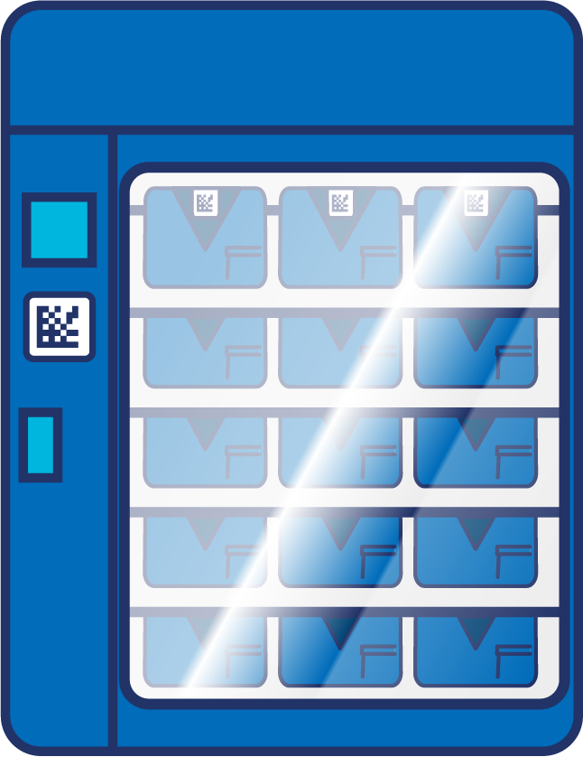
Traceability of Laundry
GLN/SSCC/GTIN/RFID
GLN/ SSCC/ GTIN
GLN/GRAI/GTIN
Textiles enter the hospital and are tagged for unique ID
Textiles are sent to the laundry where washing and disinfection cycles are recorded, ensuring full traceability of each garment
Clean textiles are distributed
To hospital care units according to the needs recorded in the system
To external services, ambulances, residences, or individuals, ensuring total control over the logistics chain

Slide 5
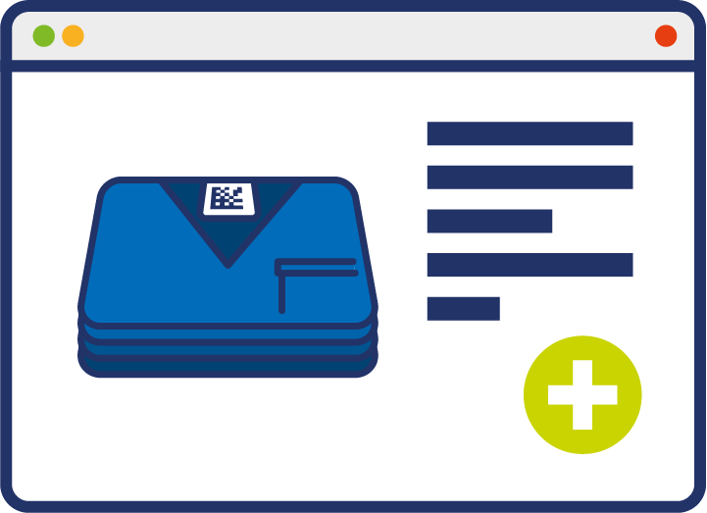
Traceability of Laundry
GLN/SSCC/GTIN/RFID
GLN/ SSCC/ GTIN
GLN/GRAI/GTIN
Textiles enter the hospital and are tagged for unique ID
Textiles are sent to the laundry where washing and disinfection cycles are recorded, ensuring full traceability of each garment
Clean textiles are distributed
To hospital care units according to the needs recorded in the system
To external services, ambulances, residences, or individuals, ensuring total control over the logistics chain
Inventory is updated automatically allowing electronic ordering to maintain optimal stock levels

Slide 6
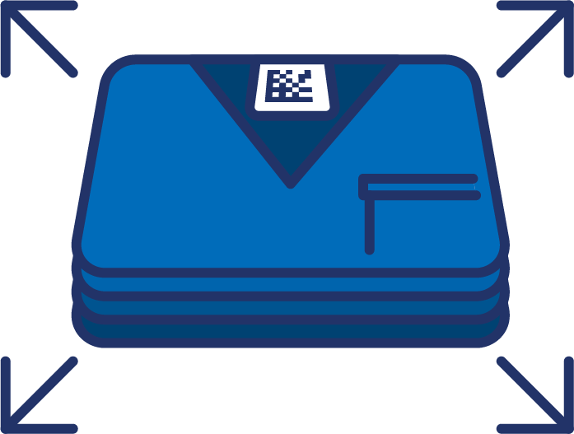
Traceability of Laundry
GLN/SSCC/GTIN/RFID
GLN/ SSCC/ GTIN
GLN/GRAI/GTIN
GLN/ GRAI/ GTIN
Textiles enter the hospital and are tagged for unique ID
Textiles are sent to the laundry where washing and disinfection cycles are recorded, ensuring full traceability of each garment
Clean textiles are distributed
To hospital care units according to the needs recorded in the system
To external services, ambulances, residences, or individuals, ensuring total control over the logistics chain
Inventory is updated automatically allowing electronic ordering to maintain optimal stock levels
Movement and usage of textiles within different hospital units are tracked

Slide 7
Traceability of Laundry
GLN/SSCC/GTIN/RFID
GLN/ SSCC/ GTIN
GLN/GRAI/GTIN
GLN/ GRAI/ GTIN
Textiles enter the hospital and are tagged for unique ID
Textiles are sent to the laundry where washing and disinfection cycles are recorded, ensuring full traceability of each garment
Clean textiles are distributed
To hospital care units according to the needs recorded in the system
To external services, ambulances, residences, or individuals, ensuring total control over the logistics chain
Inventory is updated automatically allowing electronic ordering to maintain optimal stock levels
Movement and usage of textiles within different hospital units are tracked
Dirty textiles undergo cleaning and sterilisation processes

Slide 8
Traceability of Laundry
GLN/SSCC/GTIN/RFID
GLN/ SSCC/ GTIN
GLN/GRAI/GTIN
GLN/ GRAI/ GTIN
Textiles enter the hospital and are tagged for unique ID
Textiles are sent to the laundry where washing and disinfection cycles are recorded, ensuring full traceability of each garment
Clean textiles are distributed
To hospital care units according to the needs recorded in the system
To external services, ambulances, residences, or individuals, ensuring total control over the logistics chain
Inventory is updated automatically allowing electronic ordering to maintain optimal stock levels
Movement and usage of textiles within different hospital units are tracked
Dirty textiles undergo cleaning and sterilisation processes
GLN/ GRAI/ GTIN
Continuous monitoring to support maintenance schedules and lifecycle management of textiles

Slide 9
Traceability of Laundry
GLN/SSCC/GTIN/RFID
GLN/ SSCC/ GTIN
GLN/GRAI/GTIN
GLN/ GRAI/ GTIN
Textiles enter the hospital and are tagged for unique ID
Textiles are sent to the laundry where washing and disinfection cycles are recorded, ensuring full traceability of each garment
Clean textiles are distributed
To hospital care units according to the needs recorded in the system
To external services, ambulances, residences, or individuals, ensuring total control over the logistics chain
Inventory is updated automatically allowing electronic ordering to maintain optimal stock levels
Movement and usage of textiles within different hospital units are tracked
Dirty textiles undergo cleaning and sterilisation processes
GLN/ GRAI/ GTIN
Continuous monitoring to support maintenance schedules and lifecycle management of textiles
Disposal of textiles

Slide 10
Traceability of Laundry
GLN/SSCC/GTIN/RFID
GLN/ SSCC/ GTIN
GLN/GRAI/GTIN
GLN/ GRAI/ GTIN
Textiles enter the hospital and are tagged for unique ID
Textiles are sent to the laundry where washing and disinfection cycles are recorded, ensuring full traceability of each garment
Clean textiles are distributed
To hospital care units according to the needs recorded in the system
To external services, ambulances, residences, or individuals, ensuring total control over the logistics chain
Inventory is updated automatically allowing electronic ordering to maintain optimal stock levels
Movement and usage of textiles within different hospital units are tracked
Dirty textiles undergo cleaning and sterilisation processes
PROCUREMENT
GLN/ GRAI/ GTIN
Reordering of new textiles
Continuous monitoring to support maintenance schedules and lifecycle management of textiles
Disposal of textiles

Slide 11
Benefits
Non clinical
Enables precise tracking of stock levels including wash cycles, rotation schedules, and identification of lost items. This ensures that new textiles are procured with greater efficiency and cost-effectiveness, optimising resource management for the healthcare facility
Facilitates automated stock control and seamless ordering processes across the healthcare provider ensuring availability of necessary textiles
Ensures specific handling and processing requirements due to the varying levels of contamination and the need for infection control
Ensures accountability and streamlines logistics by tracking the flow of textiles to and from laundry services

