Slide 1
Definition of business process
Process 1 – New medical equipment into organisation
This defines the process when a new item of medical equipment is ordered, delivered and registered in the medical engineering department.

Slide 2

Where the standards fit in the process map
1. Request for new asset
GTIN

Slide 3

Where the standards fit in the process map
1. Request for new asset
2. Asset registered and prepared for use
GTIN
GTIN/GIAI

Slide 4
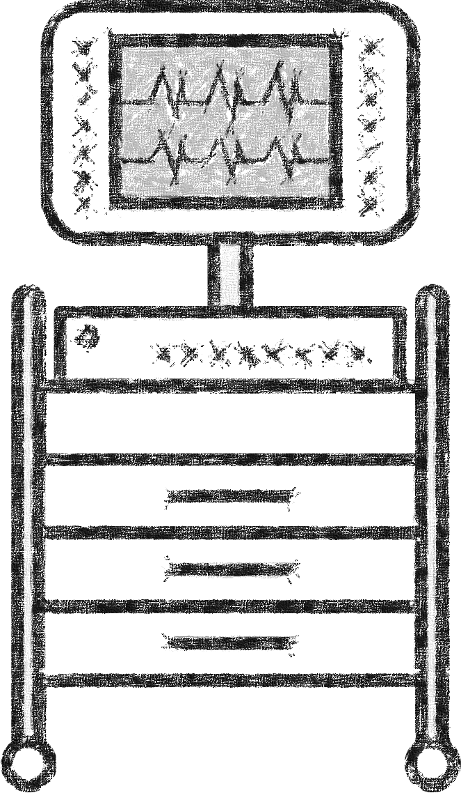
Where the standards fit in the process map
1. Request for new asset
2. Asset registered and prepared for use
3. Store the asset
GTIN
GTIN/GIAI
GTIN/GLN/GIAI

Slide 5

Where the standards fit in the process map
1. Request for new asset
2. Asset registered and prepared for use
3. Store the asset
4. Locate the asset
GTIN
GTIN/GIAI
GTIN/GLN/GIAI
GLN

Slide 6

Where the standards fit in the process map
1. Request for new asset
2. Asset registered and prepared for use
3. Store the asset
4. Locate the asset
5. Deliver the asset to the user
GTIN
GTIN/GIAI
GTIN/GLN/GIAI
GLN
GTIN/GLN/GIAI

Slide 7
Where the standards fit in the process map
1. Request for new asset
2. Asset registered and prepared for use
3. Store the asset
4. Locate the asset
5. Deliver the asset to the user
6. Use the asset
GTIN
GTIN/GIAI
GTIN/GLN/GIAI
GLN
GTIN/GLN/GIAI
GLN/GSRN(+SRIN)/GIAI

Slide 8
Where the standards fit in the process map
1. Request for new asset
2. Asset registered and prepared for use
3. Store the asset
4. Locate the asset
5. Deliver the asset to the user
6. Use the asset
7. Return the asset
GTIN
GTIN/GIAI
GTIN/GLN/GIAI
GLN
GTIN/GLN/GIAI
GLN/GSRN(+SRIN)/GIAI
GLN

Slide 9
Where the standards fit in the process map
1. Request for new asset
2. Asset registered and prepared for use
3. Store the asset
4. Locate the asset
5. Deliver the asset to the user
6. Use the asset
7. Return the asset
GTIN
GTIN/GIAI
GTIN/GLN/GIAI
GLN
GTIN/GLN/GIAI
GLN/GSRN(+SRIN)/GIAI
GLN
Does the asset needs cleaning ?

Slide 10


Where the standards fit in the process map
1. Request for new asset
2. Asset registered and prepared for use
3. Store the asset
4. Locate the asset
5. Deliver the asset to the user
6. Use the asset
7. Return the asset
GTIN
GTIN/GIAI
GTIN/GLN/GIAI
GLN
GTIN/GLN/GIAI
GLN/GSRN(+SRIN)/GIAI
GLN
Does the asset needs cleaning ?
Yes
8. Clean the asset
GTIN/GIAI

Slide 11
Where the standards fit in the process map
1. Request for new asset
2. Asset registered and prepared for use
3. Store the asset
4. Locate the asset
5. Deliver the asset to the user
6. Use the asset
7. Return the asset
GTIN
GTIN/GIAI
GTIN/GLN/GIAI
GLN
GTIN/GLN/GIAI
GLN/GSRN(+SRIN)/GIAI
GLN
No
Does the asset needs cleaning ?
Yes
9. Maintain the asset
GLN
8. Clean the asset
GTIN/GIAI

Slide 12
Where the standards fit in the process map
1. Request for new asset
2. Asset registered and prepared for use
3. Store the asset
4. Locate the asset
5. Deliver the asset to the user
6. Use the asset
7. Return the asset
GTIN
GTIN/GIAI
GTIN/GLN/GIAI
GLN
GTIN/GLN/GIAI
GLN/GSRN(+SRIN)/GIAI
GLN
Does the asset need disposing of?
No
Does the asset needs cleaning ?
Yes
9. Maintain the asset
GLN
8. Clean the asset
GTIN/GIAI

Slide 13
Where the standards fit in the process map
1. Request for new asset
2. Asset registered and prepared for use
3. Store the asset
4. Locate the asset
5. Deliver the asset to the user
6. Use the asset
7. Return the asset
GTIN
GTIN/GIAI
GTIN/GLN/GIAI
GLN
GTIN/GLN/GIAI
GLN/GSRN(+SRIN)/GIAI
GLN
Does the asset need disposing of?
No
Does the asset needs cleaning ?
Yes
Yes
9. Maintain the asset
GLN
10. Dispose the asset and decomission
8. Clean the asset
GTIN/GIAI
GTIN/GIAI

Slide 14
Where the standards fit in the process map
1. Request for new asset
2. Asset registered and prepared for use
3. Store the asset
4. Locate the asset
5. Deliver the asset to the user
6. Use the asset
7. Return the asset
GTIN
GTIN/GIAI
GTIN/GLN/GIAI
GLN
GTIN/GLN/GIAI
GLN/GSRN(+SRIN)/GIAI
GLN
11. Return the asset to store
No
Does the asset need disposing of?
No
Does the asset needs cleaning ?
Yes
Yes
9. Maintain the asset
GLN
10. Dispose the asset and decomission
8. Clean the asset
GTIN/GIAI
GTIN/GIAI

Slide 15
Benefits
Clinical
Non clinical
Assurance that medical equipment is available and in working order improving quality of care
Release time for care and enhance patient safety
Traceability of medical equipment used for infection control
Accurate asset register with scheduled maintenance cycle
Effective traceability

