Slide 1
Definition of business process
Process 1 – Transfer of deceased patient on ward into the mortuary
This is the process of preparing a deceased patient for transfer from the ward to the mortuary.

Slide 2
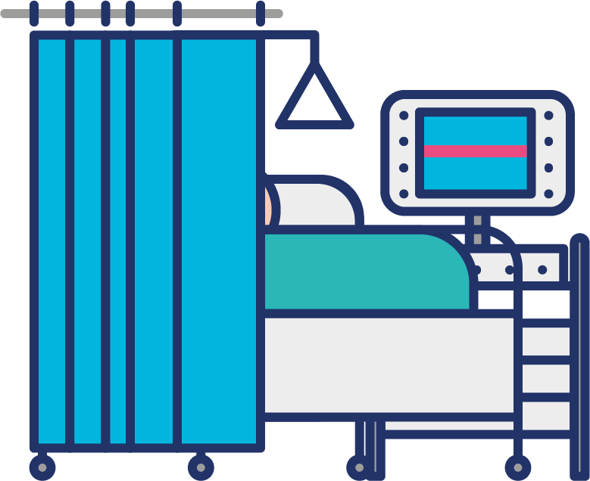
Where the standards fit in the process map
Patient deceased in hospital location
GLN
GSRN (+SRIN)

Slide 3

Where the standards fit in the process map
Patient deceased in hospital location
Patient prepared for mortuary
GLN
GSRN (+SRIN)
GLN
GSRN (+SRIN)

Slide 4

Where the standards fit in the process map
Patient deceased in hospital location
Patient prepared for mortuary
Patient collected from ward and taken to mortuary
GLN
GSRN (+SRIN)
GLN
GSRN (+SRIN)
GLN
GSRN (+SRIN)
GIAI

Slide 5

Where the standards fit in the process map
Patient deceased in hospital location
Patient prepared for mortuary
Patient collected from ward and taken to mortuary
Deceased patient transferred to mortuary
GLN
GSRN (+SRIN)
GLN
GSRN (+SRIN)
GLN
GSRN (+SRIN)
GIAI
GLN
GSRN (+SRIN)

Slide 6

Where the standards fit in the process map
Patient deceased in hospital location
Patient prepared for mortuary
Patient collected from ward and taken to mortuary
Deceased patient transferred to mortuary
GLN
GSRN (+SRIN)
GLN
GSRN (+SRIN)
GLN
GSRN (+SRIN)
GIAI
GLN
GSRN (+SRIN)
Relatives may view body
GLN
GSRN (+SRIN)

Slide 7
Where the standards fit in the process map
Patient deceased in hospital location
Patient prepared for mortuary
Patient collected from ward and taken to mortuary
Deceased patient transferred to mortuary
GLN
GSRN (+SRIN)
GLN
GSRN (+SRIN)
GLN
GSRN (+SRIN)
GIAI
GLN
GSRN (+SRIN)
Relatives may view body
GLN
GSRN (+SRIN)
Patient requires
post-mortem
GLN
GSRN (+SRIN)
GIAI

Slide 8

Where the standards fit in the process map
Patient deceased in hospital location
Patient prepared for mortuary
Patient collected from ward and taken to mortuary
Deceased patient transferred to mortuary
GLN
GSRN (+SRIN)
GLN
GSRN (+SRIN)
GLN
GSRN (+SRIN)
GIAI
GLN
GSRN (+SRIN)
Relatives may view body
GLN
GSRN (+SRIN)
Patient requires
post-mortem
Samples going to pathology laboratory’
GLN
GSRN (+SRIN)
GIAI
GLN
GSRN (+SRIN)
GIAI

Slide 9
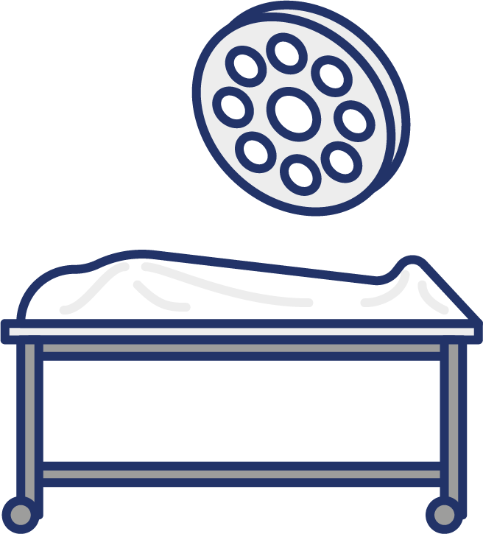
Where the standards fit in the process map
Patient deceased in hospital location
Patient prepared for mortuary
Patient collected from ward and taken to mortuary
Deceased patient transferred to mortuary
GLN
GSRN (+SRIN)
GLN
GSRN (+SRIN)
GLN
GSRN (+SRIN)
GIAI
GLN
GSRN (+SRIN)
Relatives may view body
GLN
GSRN (+SRIN)
Yes
Patient requires
post-mortem
Samples going to pathology laboratory’
Patient post-mortem complete
GLN
GSRN (+SRIN)
GIAI
GLN
GSRN (+SRIN)
GIAI
GLN
GSRN (+SRIN)
GIAI

Slide 10

Where the standards fit in the process map
Patient deceased in hospital location
Patient prepared for mortuary
Patient collected from ward and taken to mortuary
Deceased patient transferred to mortuary
GLN
GSRN (+SRIN)
GLN
GSRN (+SRIN)
GLN
GSRN (+SRIN)
GIAI
GLN
GSRN (+SRIN)
Relatives may view body
GLN
GSRN (+SRIN)
No
Patient
ready to collect by funeral director
Yes
Patient requires
post-mortem
Samples going to pathology laboratory’
GLN
GSRN (+SRIN)
Patient post-mortem complete
GLN
GSRN (+SRIN)
GIAI
GLN
GSRN (+SRIN)
GIAI
GLN
GSRN (+SRIN)
GIAI

Slide 11
Benefits
Clinical
Non clinical
Accurate identification of the deceased patient to confirm accurate location of deceased patient
Accurate identification of the deceased patient to inform relatives when transfer has taken place
Accurate identification of the location of the deceased patient to inform relatives

