Slide 1
Definition of business process
Process 2 – Inventory Management
Inventory management in hospitals involves the management of stock items used in patient care. This covers both high use/low-value items such as swabs and syringes, as well as expensive implants and surgical kits.

Slide 2
Where the standards fit in the process map
Procurement

Slide 3
Where the standards fit in the process map
Stock Storage
Procurement

Slide 4
Where the standards fit in the process map
Stock Storage
Stock control
Procurement

Slide 5
Where the standards fit in the process map
Stock Storage
Stock control
Point of care usage
Procurement

Slide 6
Where the standards fit in the process map
Stock Storage
Stock control
Point of care usage
Procurement
Recording in EHR

Slide 7
Where the standards fit in the process map
Stock Storage
Stock control
Point of care usage
Procurement
Recording in EHR
Medical Billing/ coding

Slide 8
Where the standards fit in the process map
Stock Storage
Stock control
Point of care usage
Procurement
Recording in EHR
Reimbursement
Medical Billing/ coding

Slide 9
Where the standards fit in the process map
Stock Storage
Stock control
Point of care usage
Procurement
Recording in EHR
Reimbursement
Medical Billing/ coding

Slide 10
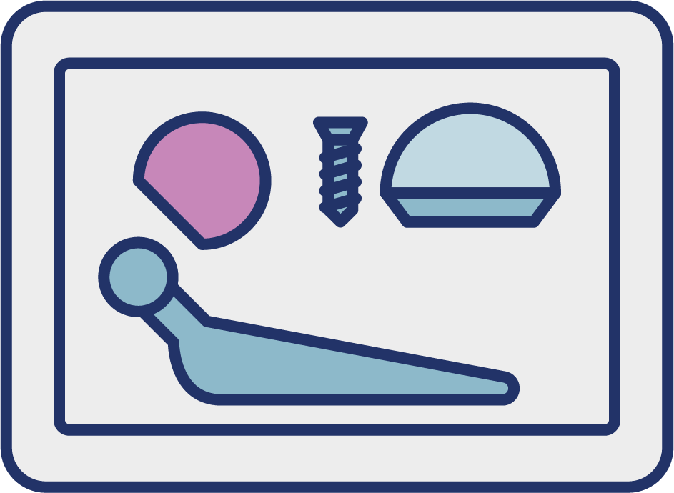
Where the standards fit in the process map
Surgical procedure list detailing all products required
Stock Storage
Stock control
Point of care usage
Procurement
Recording in EHR
Reimbursement
Medical Billing/ coding

Slide 11
Where the standards fit in the process map
Surgical procedure list detailing all products required
Products picked from stock
Stock Storage
Stock control
GTIN
Point of care Usage
Procurement
Recording in EHR
Reimbursement
Medical Billing/ coding

Slide 12
Where the standards fit in the process map
Surgical procedure list detailing all products required
Products picked from stock
Stock Storage
Stock control
GTIN
Point of care Usage
Placed on trolley and taken to place of care e.g. operating room /bedside
Procurement
Recording in EHR
Reimbursement
Medical Billing/ coding

Slide 13
Where the standards fit in the process map
Surgical procedure list detailing all products required
Products picked from stock
Stock Storage
Stock control
GTIN
Point of care Usage
Placed on trolley and taken to place of care e.g. operating room /bedside
Patient wristband scanned
Procurement
GSRN (+SRIN)
Recording in EHR
Reimbursement
Medical Billing/ coding

Slide 14
Where the standards fit in the process map
Surgical procedure list detailing all products required
Products picked from stock
Stock Storage
Stock control
GTIN
Point of care Usage
Placed on trolley and taken to place of care e.g. operating room /bedside
Patient wristband scanned
Procurement
GSRN (+SRIN)
Recording in EHR
Items used or implanted scanned and captured in EHR
Reimbursement
Medical Billing/ coding
GTIN

Slide 15
Where the standards fit in the process map
Surgical procedure list detailing all products required
Products picked from stock
Stock Storage
Stock control
GTIN
Point of care Usage
Placed on trolley and taken to place of care e.g. operating room /bedside
Patient wristband scanned
Procurement
GSRN (+SRIN)
Recording in EHR
Items used or implanted scanned and captured in EHR
Unused items returned to stock
Reimbursement
Medical Billing/ coding
GTIN
GTIN

Slide 16
Benefits
Clinical
Non Clinical
Reduction in errors resulting in improved patient safety
Right products at the right time and in the right place
Easily move inventory to where its needed
Released time to care
Reduction in administrative burden
Reduction in waste/ obsolescence
Efficient payment processes

