Slide 1
Definition of business process
Process 1 – Scanning implants at the point of care
Interventional radiology (IR) is a medical specialty that employs minimally invasive image-guided procedures to diagnose and treat diseases.This process details a patient going through the interventional radiology process. Scanning implants at the point of care enables accurate data to be captured in both the Electronic Health Record (EHR) & Inventory Management System (IMS) enabling efficient data entry, recall and re-ordering.

Slide 2
Where the standards fit in the process map
Elective access

Slide 3
Where the standards fit in the process map
Elective access
Emergency access

Slide 4
Where the standards fit in the process map
Elective access
Identification of the patient and procedure required with consent signed
GLN
GSRN (+SRIN)
GDTI
Emergency access

Slide 5
Where the standards fit in the process map
Elective access
Identification of the patient and procedure required with consent signed
Products, medical devices and medical equipment available
GLN
GSRN (+SRIN)
GDTI
GTIN
GIAI
Emergency access

Slide 6
Where the standards fit in the process map
Elective access
Identification of the patient and procedure required with consent signed
Products, medical devices and medical equipment available
Staff involved
in procedure scanned
GLN
GSRN (+SRIN)
GDTI
GTIN
GIAI
GSRN (+SRIN)
Emergency access

Slide 7
Where the standards fit in the process map
Elective access
Identification of the patient and procedure required with consent signed
Products, medical devices and medical equipment available
Staff involved
in procedure scanned
Product and medical devices scanned at point of care when implanted into patient
GLN
GSRN (+SRIN)
GDTI
GTIN
GIAI
GSRN (+SRIN)
GTIN
GIAI
Emergency access

Slide 8
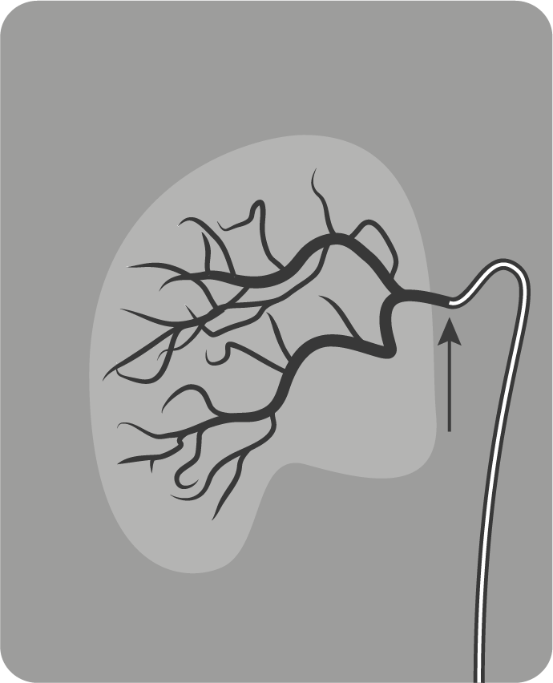
Where the standards fit in the process map
Product and medical devices scanned at point of care captured in EHR
Elective access
Identification of the patient and procedure required with consent signed
Products, medical devices and medical equipment available
Staff involved
in procedure scanned
Product and medical devices scanned at point of care when implanted into patient
GLN
GSRN (+SRIN)
GDTI
GTIN
GIAI
GSRN (+SRIN)
GTIN
GIAI
Emergency access

Slide 9
Where the standards fit in the process map
Product and medical devices scanned at point of care captured in EHR
Elective access
Identification of the patient and procedure required with consent signed
Products, medical devices and medical equipment available
Staff involved
in procedure scanned
Product and medical devices scanned at point of care when implanted into patient
GLN
GSRN (+SRIN)
GDTI
GTIN
GIAI
GSRN (+SRIN)
GTIN
GIAI
Emergency access
PROCUREMENT
Product and medical devices scanned at point of care subtracted from inventory and reordered if required / invoiced

Slide 10
Where the standards fit in the process map
Product and medical devices scanned at point of care captured in EHR
Elective access
Identification of the patient and procedure required with consent signed
Products, medical devices and medical equipment available
Staff involved
in procedure scanned
Product and medical devices scanned at point of care when implanted into patient
Patient home or goes to ward
GLN
GSRN (+SRIN)
GDTI
GTIN
GIAI
GSRN (+SRIN)
GTIN
GIAI
Emergency access
PROCUREMENT
Product and medical devices scanned at point of care subtracted from inventory and reordered if required / invoiced

Slide 11
Benefits
Clinical
Non clinical
Releases time for nurses to care for patients
Simplicity when capturing accurate data in the EHR
Accurate capture of products used so accurate reordering is complete
Products available for planned procedures
Efficient recall timelines

